Slide 1


Change Management in a Large CRO;
Investing for the Future
Martin Brown
Statistical Science Director
PPD, Part of Thermo Fisher Scientific
PSI SIG AIMS Chair

Slide 2


Running the Open-Source Marathon!
“Like a marathon, the change to using R and other open-source languages is a challenge that requires preparation, pacing and perseverance”
Notes:
It is a challenge for a mainly SAS saturated industry to take on
Are you going to be ready for the race?!

Slide 3
Running the Open-Source Marathon!
Are you going to be ready for the race?!
Notes:
It is a challenge for a mainly SAS saturated industry to take on
Are you going to be ready for the race?!

Slide 4
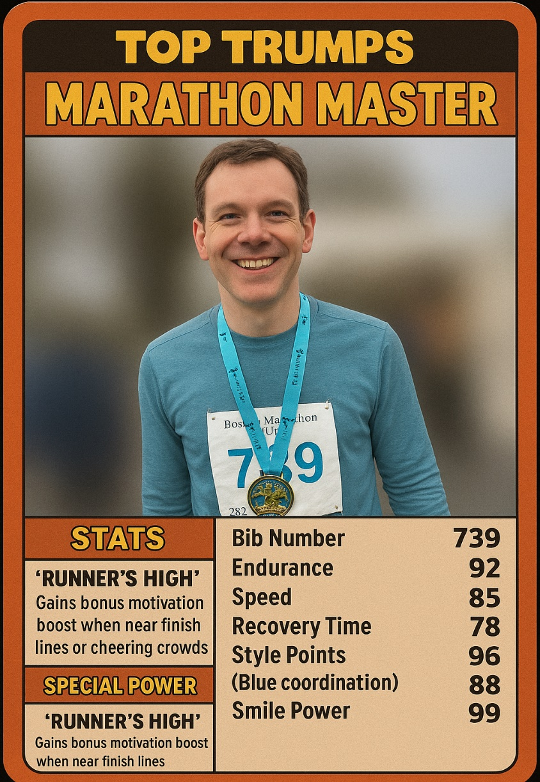
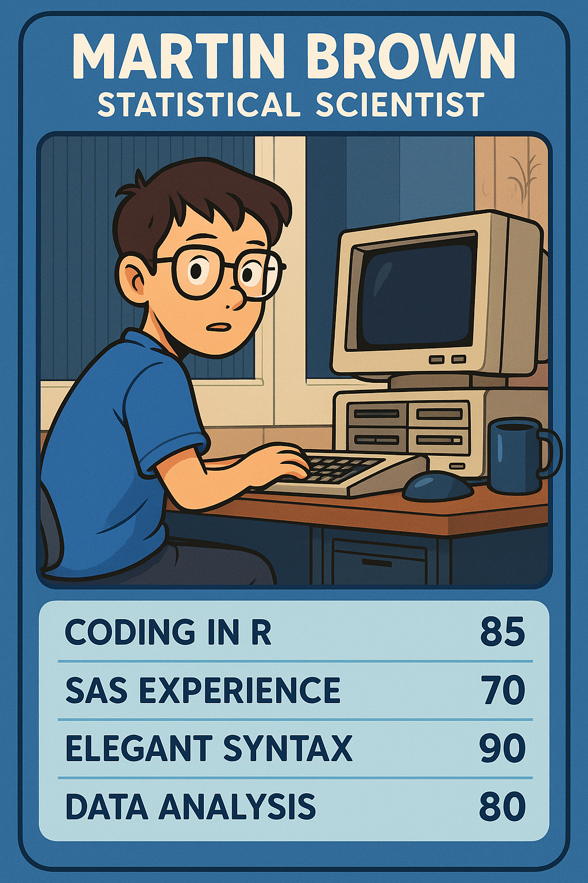

My Running + R Journey
MARTIN BROWN
CASUAL RUNNER
MARATHON
1!
Notes:
Top Trumps-style runners card with an introduction to you and your journey with R.
Like sport – done bits and pieces!
Average casual runner!
3 races
Abington 10k 2014
Wolf run 2017
Boston (UK) marathon
Look after statistical software
Mainly used R at university
Like many then mainly used SAS when I started here in 2007
Used R on a small number of specific projects
2018 became part of statistical science group
2019 joined the AIMS SIG and started our R journey

Slide 5
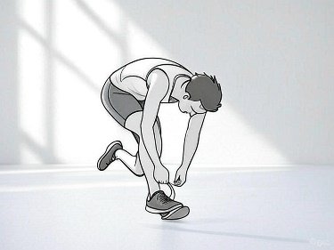
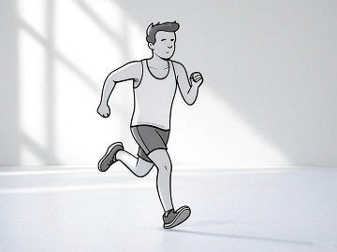
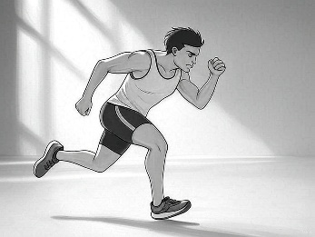
Running the Open-Source Marathon!
Open-Source Success
Preparation
Pacing
Perseverance
Finish Line
Infrastructure
Goals
Leadership
Keep finding ways to use R
Immersion
Training
Communication
CRO challenges
General challenges
Collaboration
Adaptability

Slide 6


Pause! – Where are you starting from?
The Couch?
As an Olympic Triathlon Gold Medalist?
Notes:
(No to little running) vs. (Alex Yee)
When I first started assessing our R capabilities in 2019 – no R studio, no defined processes for using R in study work
Personally and as a group, department, company
Honest assessment
Mix of people

Slide 7
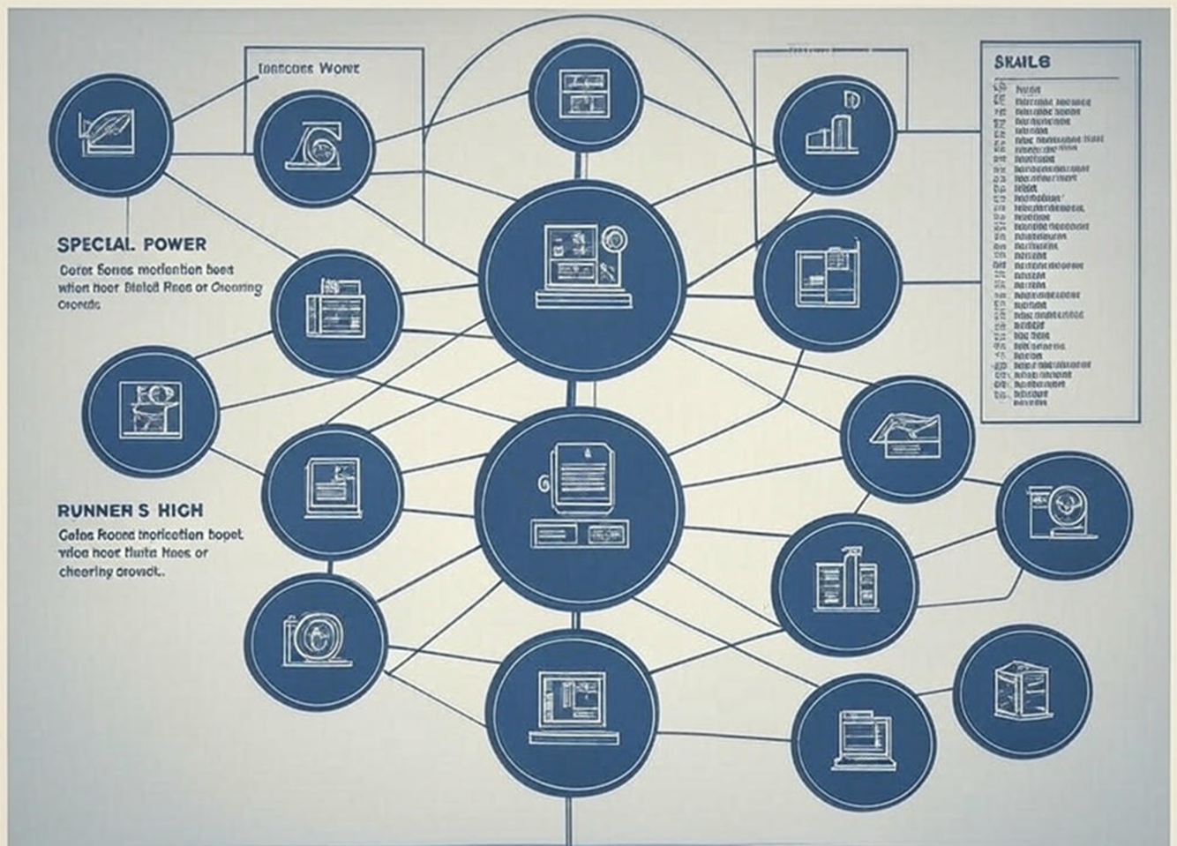
Infrastructure
What infrastructure do you have available?
Statistical Computing Environment
What are your processes?
Assess
What do we have already?
What do we need?
What do we need to repurpose?
What do we need to create?
Preparation
Notes:
Cloud computing, virtual machines, containers
BTI - citrix virtual desktop images
Tortoise SVN repository system

Slide 8

Goals
Need to know where we are headed (distance, time)
Set clear and achievable goals – Be SMART
Specific, Measurable, Achievable, Relevant, Time-bound
Set for different levels
Individual
Keep on top of what’s going on
How do I carry out this particular analysis in R?
Group
X% of department will be familiar with the tidyverse, admiral
Be able to respond to client requests
Strengths and weaknesses
What are you interested in?
Doesn’t need to be complex
Lots of low hanging fruit
Small quick wins
Remember!
Preparation
Notes:
Lots of aspects
Easy to be swept up into hype or panic or both!
What are the expectations?
What are your horizons?
Blog series
it’s important to focus on what we can control, and channel our best efforts and energy into the areas of biggest impact.
Within 8 weeks, I will learn how to perform an MMRM analysis in R and contribute my learning to CAMIS
Just focus on the next interval!
Learning and doing together
Think about multiple example of things I have planned
What is covered adequately by other solutions
Start where you are
Initially
R version, R studio installation,
Process for using one package
Dived into Shiny

Slide 9
Goal Examples
Create a laboratory spaghetti plot from the CDISC pilot data using the tidyverse
Find out about Quarto or R Markdown and publish an example
Drive the use of R for innovative solutions within the business segment.
Advocate for and support the development of R programming skills
Learn what is required for an R only submission
Need help?
Reach out!
Preparation

Slide 10


Leadership
Effective change requires strong leadership to:
drive the process
motivate employees,
address resistance
Leaders should be
Visible
Accessible
Committed to the Change
Bringing People on Board
Important Points
Clear support from the top
Building a large set of experts / champions
Passion
Feedback loop
Preparation
Notes:
Speaking how to handle it
Technical / people / process
Direct line
Feedback loop on an ongoing basis
Finding particular people who are interested, who have time – less tied up in projects, less utilised
Meet with those people

Slide 11

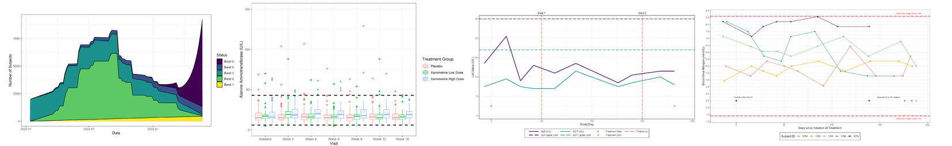
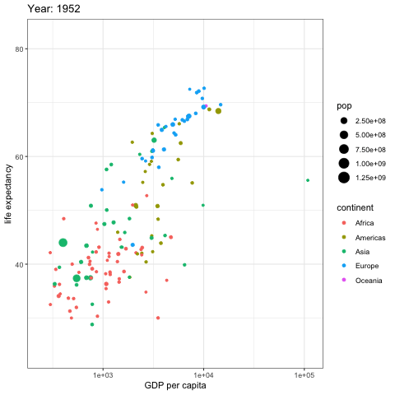
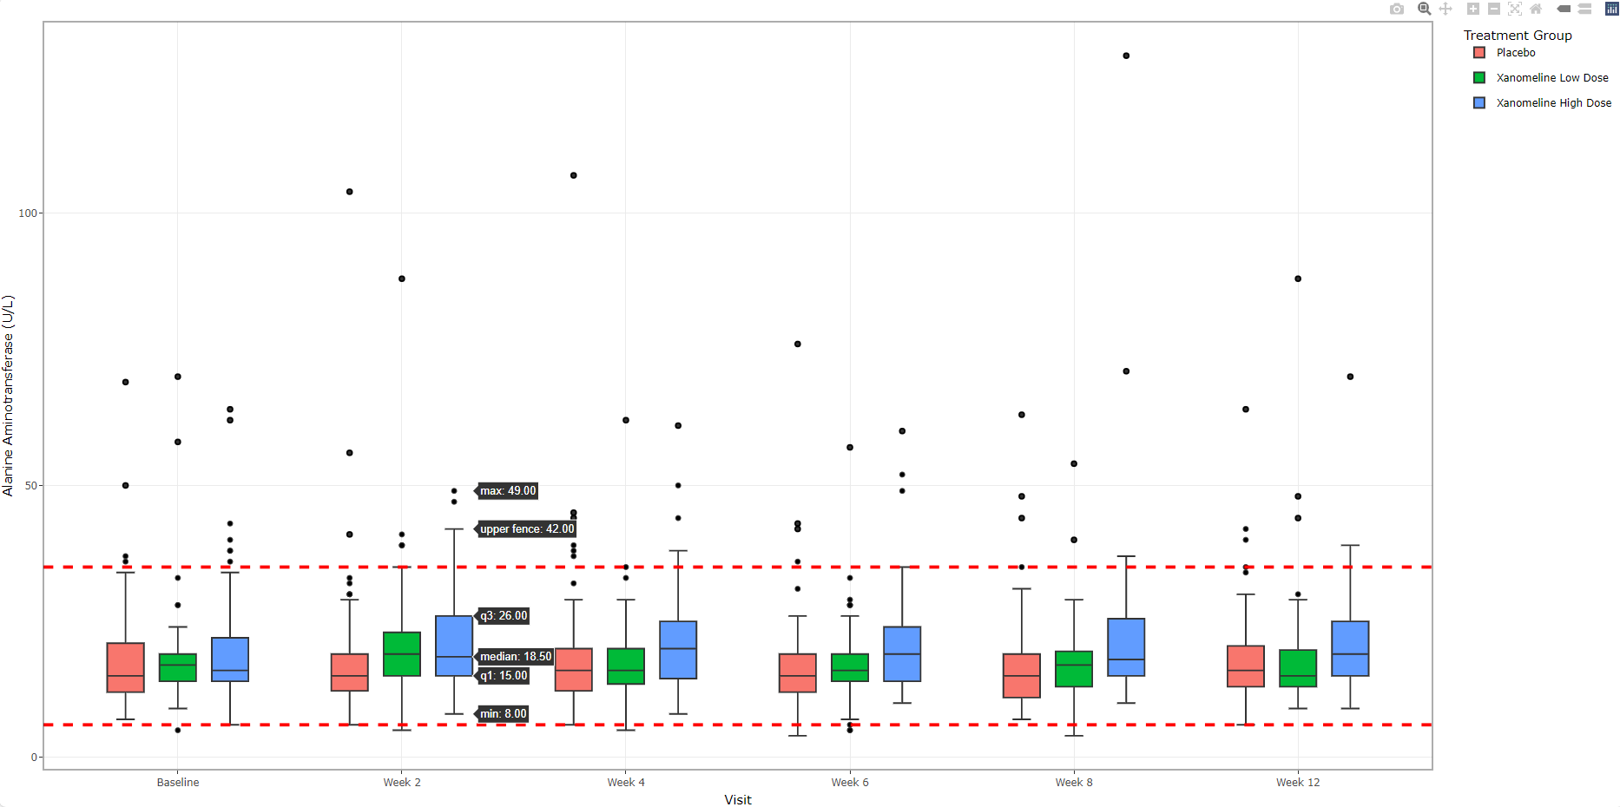
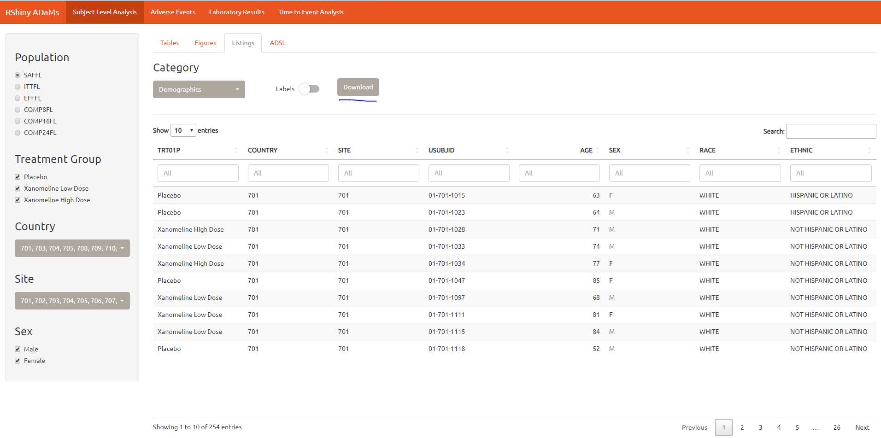
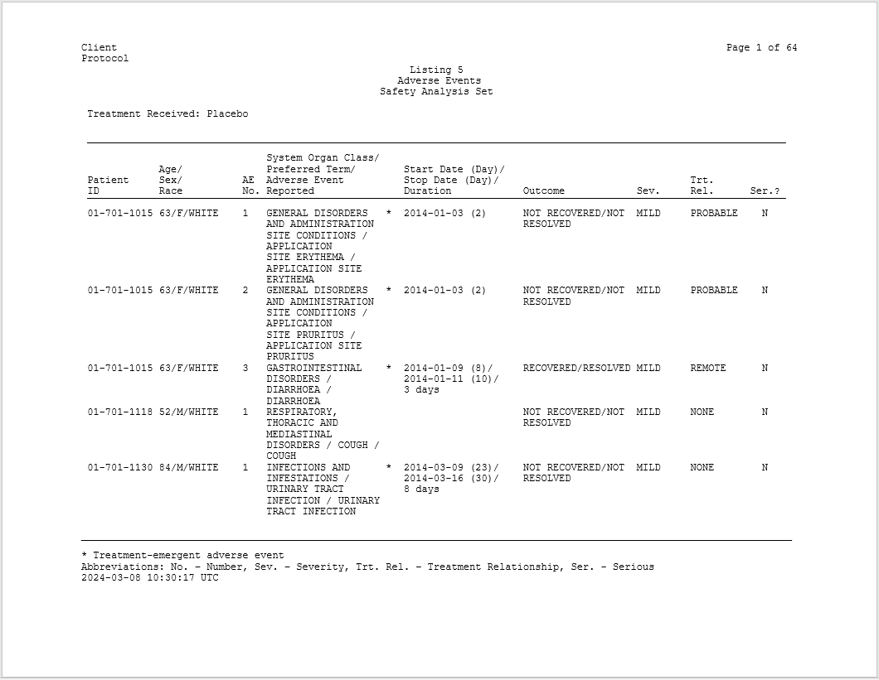
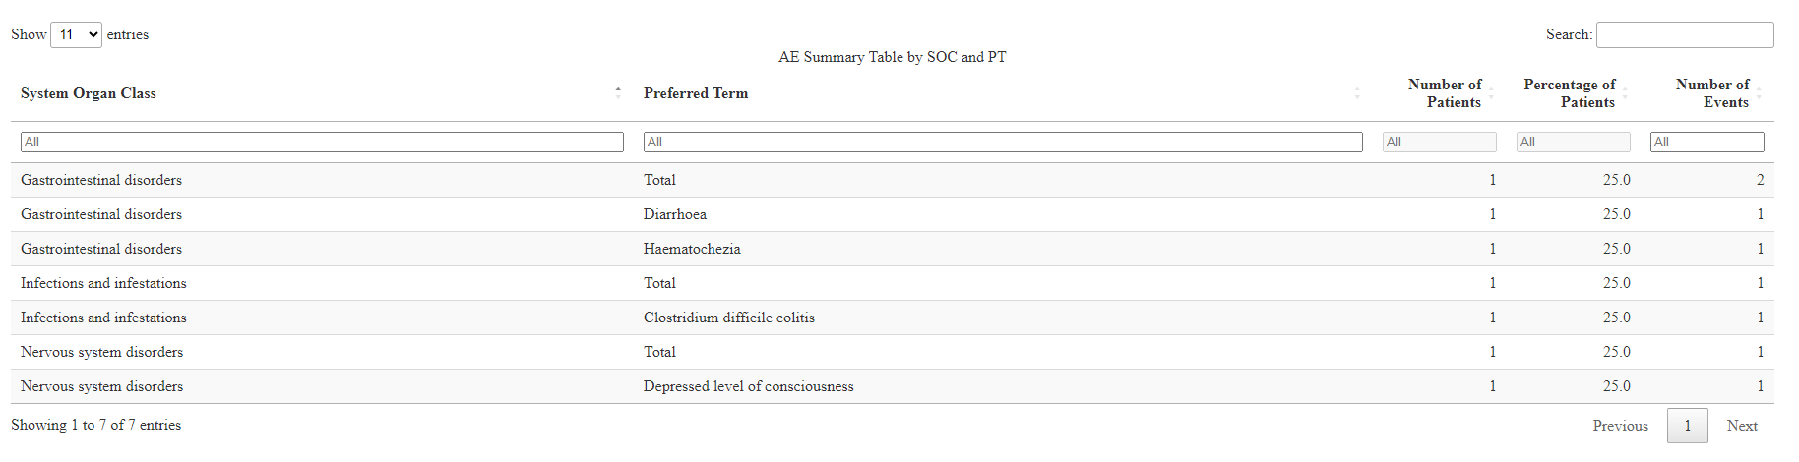
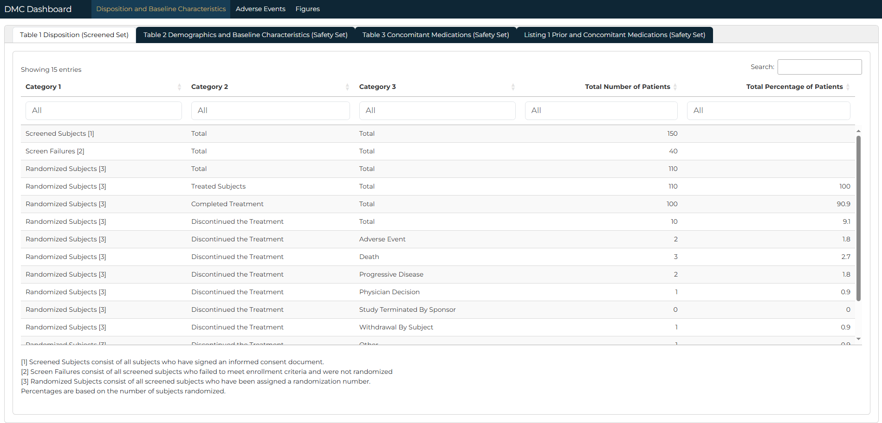
Keep the Pace Up!
What is your pace?! 1 particular aspect up to multiple – look for solutions
Use R as driver for new innovative solutions
Dealing with lots of data, more interactive solutions, more efficiency
Start projects
Create opportunities so training is effective
Look to drive different areas if possible
Create working groups
Simulation
Figures
R within SAS
R Markdown / Quarto
Bayesian
Shiny
Pacing
Notes:
Get going
Interactive datatables with DT, figures with plotly
Individual analyses – proc lifetest fix, imputation methods
Shiny internally externally
How am I going to start using R
One particular challenge / benefit of being a CRO/consultant
Looking to please multiple sets of people – leads to multiple possibilities – helps use R more
Not much need for Python at the moment

Slide 12
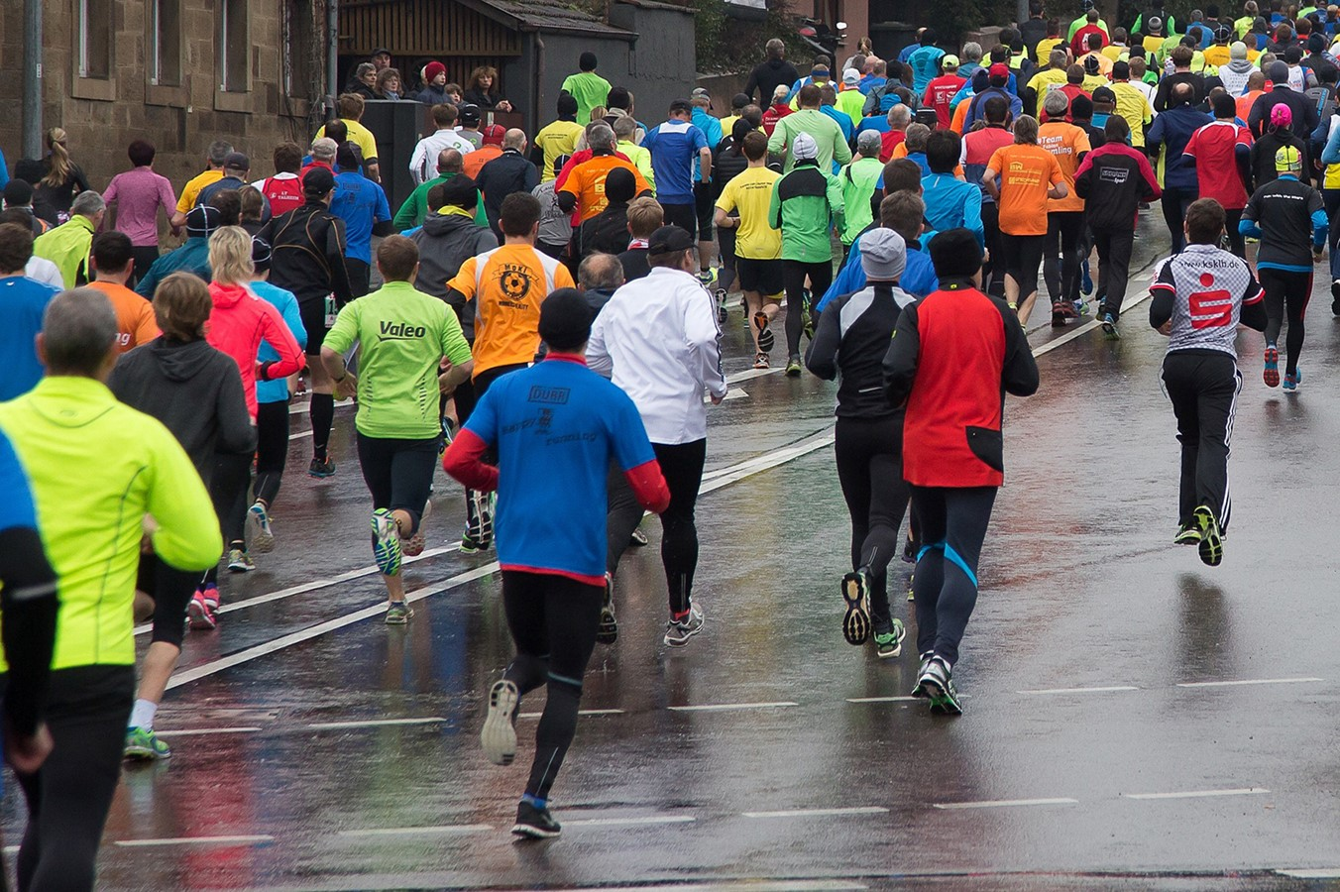
Immerse Yourself!
Get involved with a working group / submit issues / help with packages
Projects in line with your interests
Attend conferences
Videos / Webinars
Follow news (LinkedIn, blogs)
Little and often!
Pacing
Notes:
As an individual or group
Nothing has been more helpful than this
Trying out lots of different things in R
Creating training

Slide 13

Immerse Others! Training as you Go
Build open-source awareness and skills
Courses and resources available – gaps – disjointed – pulling resources together
Produced an 8 module R Academy course
Practical
Industry focused and industry examples
Given over 8 weeks live initially
Recorded and videos available to many
Gets people started
Carry out specific training just-in-time
Pacing
Notes:
Running – easy to be intermittent
See a sporting event – London Marathon, French Open – want to do it, do it once and not keep it up
Think about multiple example of things I have planned

Slide 14


Good Communication is Vital
"Communication is the bridge between confusion and clarity."
– Nat Turner
Regularity
Effectiveness
Sharing vision and ideas
Demonstrations
Support
Resources
Pacing
Notes:
Speak to people regularly about R but am I effective?
What is currently going on in the industry?
What are you currently using R/open-source for?
How are you getting on?

Slide 15
CRO Challenges
Multiple projects / processes in SAS
Meet deadlines!
Stay highly utilized!
Use R and SAS together
Many clashing priorities
Multiple solutions being developed by clients
Make R billable
Be specific
Fight for it – stress importance
Stay as flexible as possible
Make a choice!
Explore!
Perseverance
Notes:
Running shoes
Less budget for dedicated exploratory resources / staff more
Proc iml and validation R alone, exploratory
Current project work in SAS
Multiple clients
Don’t want to mess up what’s working well
Other clashing priorities
New ways of working have not settled down
What do we use?
What do we explore?
Multiple clients to use multiple packages
Try things out – keep up with what’s going on
Utilisation
Wait or go ahead? Invest for the future! Be bold
stretched

Slide 16
General Challenges
Speed increase
Misconceptions
Cost
Resistance
Aligning diverse stakeholders
Strong feelings
Building trust
Liability / Licensing
Collaborate
Stay Adaptable
Perseverance
Notes:
What are the open-source challenges?
It is not slowing down – it is speeding up!
Perception – during a significant change, dealing with
Inconsistent practices
Short term productivity losses
Building trust in open-source for regulatory use

Slide 17



Collaborate
It is hard – we need each other
Similarities of the running and open-source communities!
Cross-functional
Biostatisticians, programmers, IT, regulatory affairs, data management, PK, RWE
Pooling resources
Knowledge sharing
Building solutions, packages
Keep on asking questions
Phuse Q&A online book
Stay Adaptable
Be flexible and willing to adjust plans
Working groups
Project execution
Experiment
Monitor and evaluate
Perseverance

Slide 18
Conclusion and Next Steps
“Adopting R and open-source tools is a marathon, not a sprint. With preparation, pacing, and perseverance, we can cross the finish line together and achieve open-source success and multilingual confidence”
Perseverance
Pacing
Preparation
Face and overcome challenges
Foster collaboration
Stay adaptable
Keep the pace up
Immerse yourself
Keep training as you go
Communicate
Set clear goals
Leadership commitment
Assess infrastructure
Notes:
do we need something further / do I need to get to know what I have

Slide 19
Questions?

Slide 20
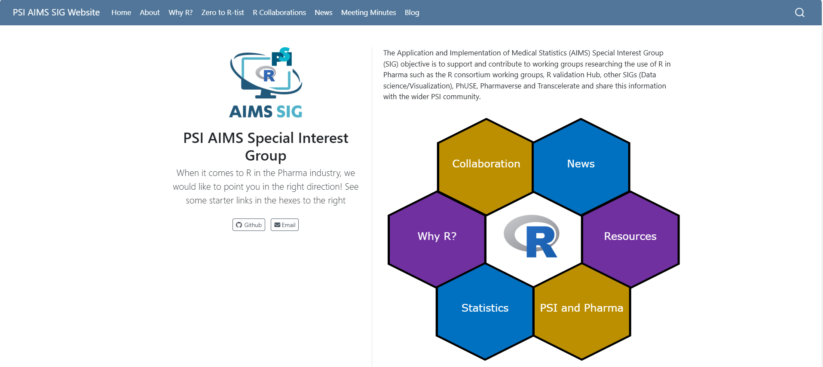

R Industry Collaborations
PSI SIGS
AIMS – PSI AIMS Special Interest Group – PSI AIMS SIG Website
Openstatsware – openstatsware
Phuse Working Groups
CAMIS – CAMIS - A PHUSE DVOST Working Group
Teal Enhancements for Cross-Industry Adoption – Teal Enhancements for Cross-Industry Adoption - WORKING GROUPS - PHUSE Advance Hub
Emerging Trends & Innovation (multiple) – Emerging Trends & Innovation - WORKING GROUPS - PHUSE Advance Hub
pharmaverse – pharmaverse
R Consortium isc-working-groups – R Consortium
R Validation Hub – pharmaR website
Submissions Working Group – Introduction – R Submissions Working Group
RTRS – Tables in Clinical Trials with R
HTA Working Group – RConsortium/HTA-wg

Slide 21
R Industry Webinars / Conference
R Adoption Series – Webinars – R Consortium
R in Pharma – R/Pharma
R in Medicine – R/Medicine 2025
PharmaSUG – PharmaSUG – Software Users Group of life science and health research professionals
PHUSE EU / US Connect – Archive Page | PHUSE / SAS Proceedings and more
PSI Conference – Home
Posit Conf. – posit::conf | R & Python Data Science Conference - Posit
UseR! – useR! 2025

